Slide 1
Panoramic view of web api
- Karen Immanuel

Slide 2


What is an API?
Application Programming Interface
It provides the conventions to interact with applications without knowing the internal logic of the code
Examples:

Slide 3
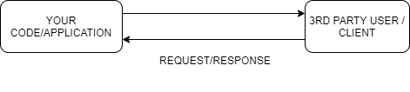
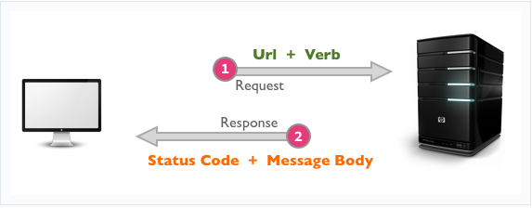
Build an API for your code
Source : Google images

Slide 4
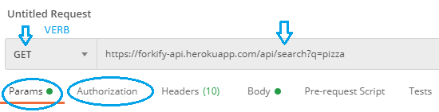
Request parameters of API
Http verb:
GET
POST
PUT
DELETE
URL
Request parameters
Authorization:
No auth
Password based
API Key based
Token based
https://forkify-api.herokuapp.com/api/search?q=pizza

Slide 5
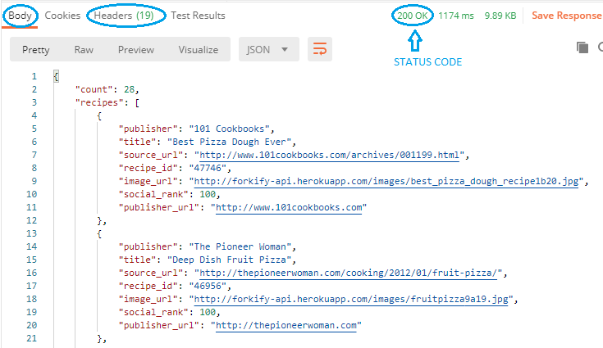
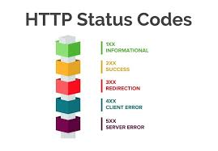
Response parameters of API
Source : Google images

Slide 6
REST API
Based on seven principles
Representation of Resources -> URL
Example:
http://example.com/api/books
Basic operations on resources - CRUD
C
R
U
D
Create (SQL INSERT) : POST – Create a resource
Read (SQL SELECT) : GET - Retrieve a representation of a resource
Update (SQL UPDATE) : PUT - Update a resource using a full representation
Delete (SQL DELETE) : DELETE - Delete a resource.

Slide 7
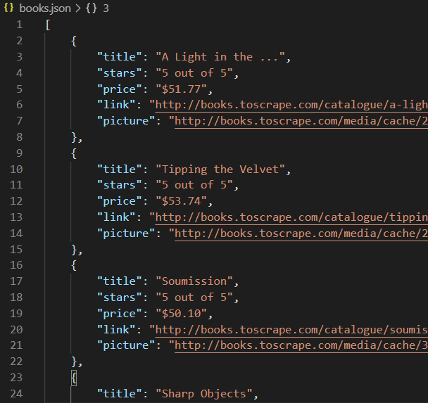
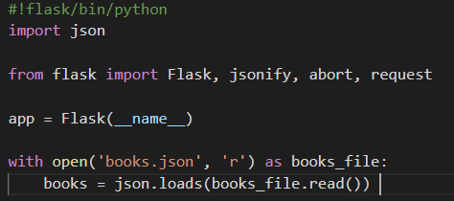
Example
Sample Data source
JSON data
Can also be from DB
FLASK IMPLEMENTATION

Slide 8
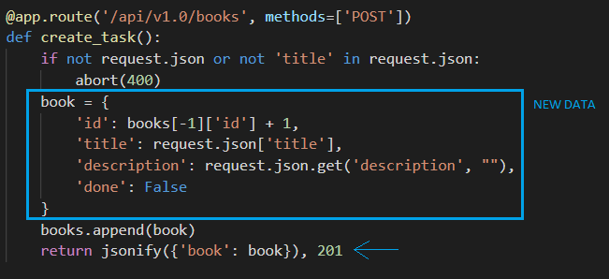
API to perform Basic CRUD OPERATIONS

Slide 9
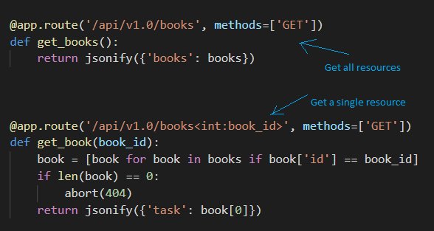
API to perform Basic CRUD OPERATIONS

Slide 10
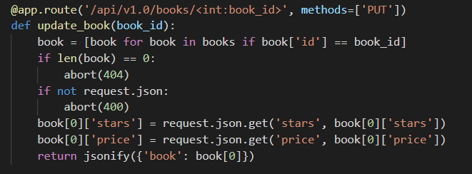
API to perform Basic CRUD OPERATIONS

Slide 11
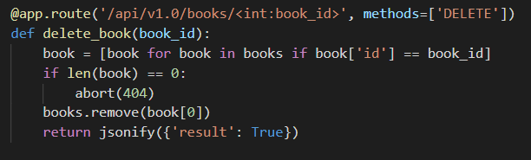
API to perform Basic CRUD OPERATIONS

Slide 12
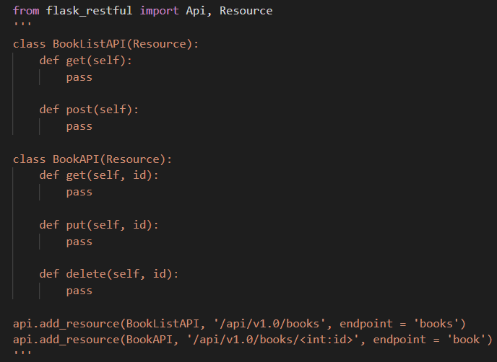
Flask-restful template

Slide 13
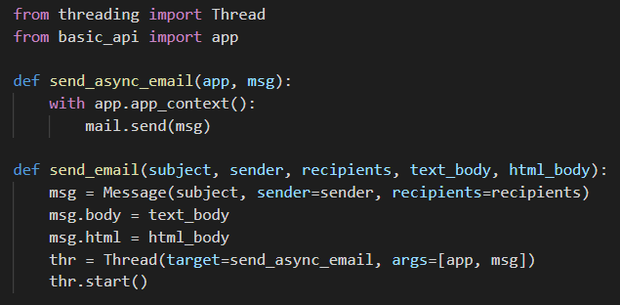
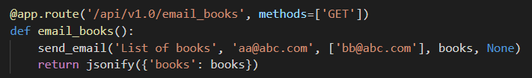
Long running tasks
Example – Sending an email
It can block the API.

Slide 14
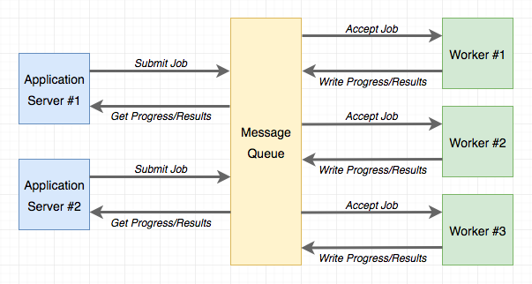
Long running tasks – Background tasks
Need non-blocking request/responses
Task Queue – Celery
Source : Google images

Slide 15
Threading Vs. Task Queue
Task queues have distributed architecture
Scales application extremely well
Add more workers according to load
Does not block the API

Slide 16
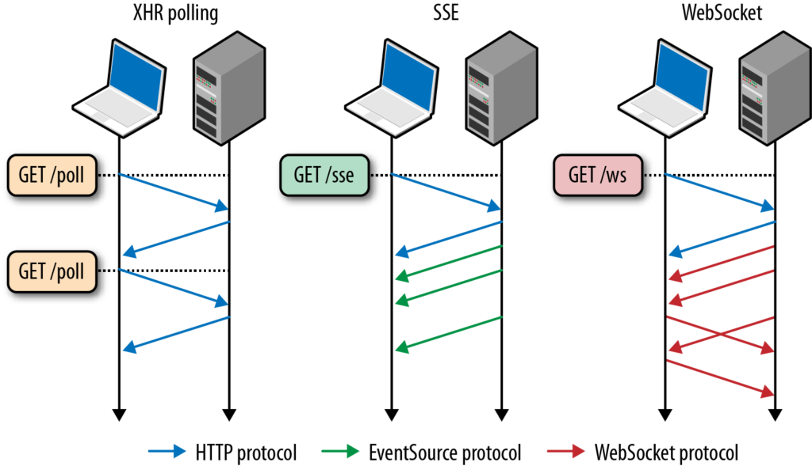
Status of background task
Client will know that background task started.
Update status in non blocking way
Polling
Web socket
Server sent events
Source : Google images

Slide 17
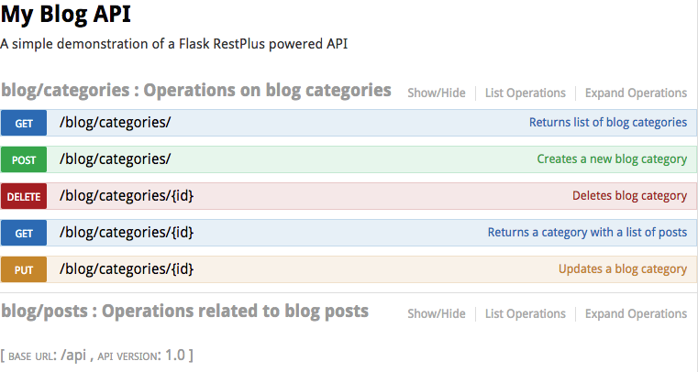
API Documentation with Swagger tool
Good documentation is essential for APIs
Take care of versioning and backward compatibility
<code snippet of swagger plugin in flask>
Source : Google images
Output of a well- organized API doc

Slide 18
Serverless deployment with Zappa
While developing, APIs run on local server
For your APIs to be accessed by clients/3rd party users, they must be in a server.
Instead of dedicated server, we can go serverless
For personal projects or quick testing we can go with the option of serverless deployment.
Easy to setup
Demo/screenshot of serverless deployment with Zappa

